Slide 1






Unified MEDS Accelerator
Sanjay Deshpande, Yongseok Lee, Mamuri Nawan, Kashif Nawaz, Ruben Niederhagen, Yunheung Paek, Jakub Szefer

Slide 2
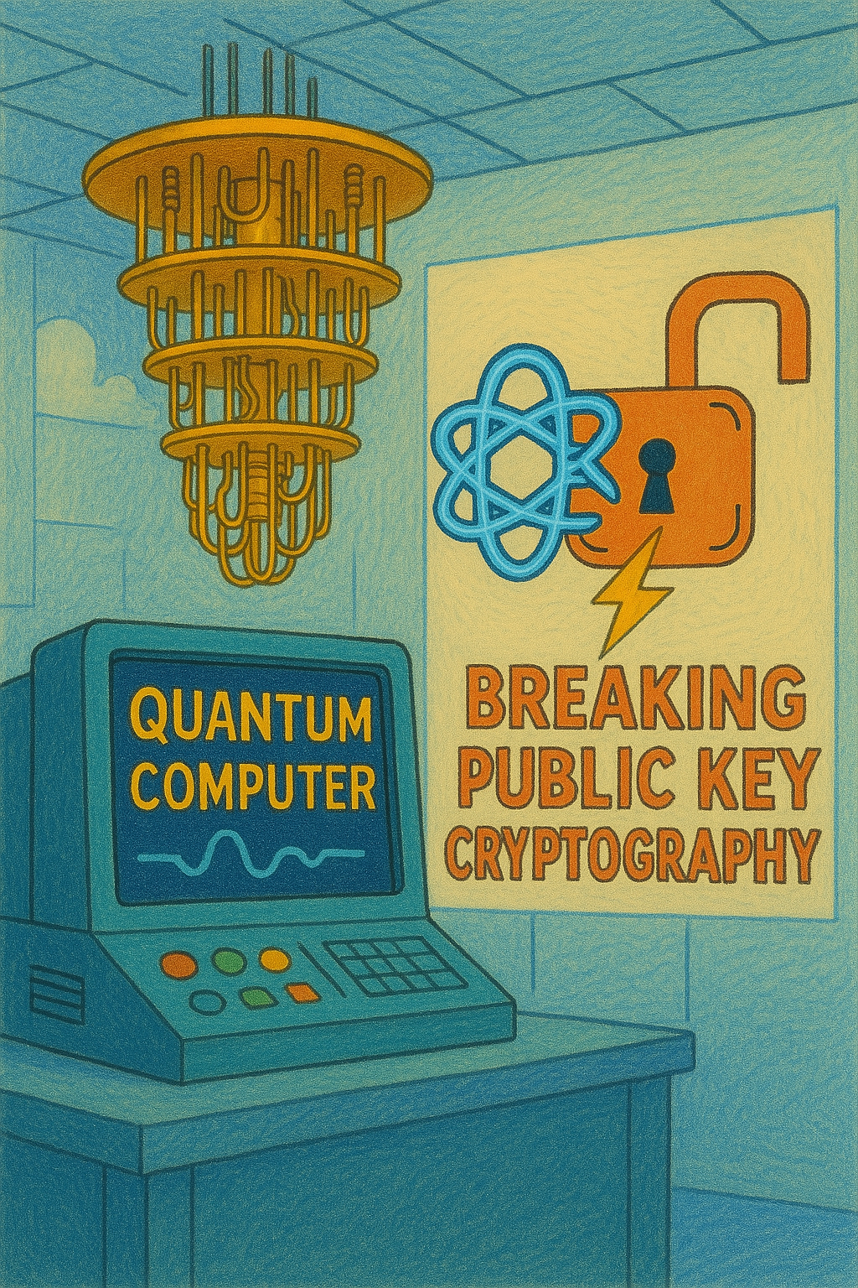






Modern Cryptography
Symmetric-key cryptography
Public-key cryptography
  Shor’s algorithm can potentially break existing pre-quantum public-key cryptosystems (e.g., RSA).
Post-Quantum Cryptography to the rescue!
Post-Quantum Cryptography standardization efforts are in progress around the world.
Notes:
Modern cryptography forms the backbone of security in today's digital applications. It primarily comprises of symmetric key cryptography and public key cryptography.
However, the rise of quantum computing—and ongoing advances toward building quantum computers capable of breaking current cryptographic standards—pose a significant threat to pre-quantum public key cryptosystems.
A quantum algorithm called Shor’s algorithm can potentially help break existing pre-quantum public-key cryptosystems such as RSA
Post-quantum cryptography provides a beacon of hope. These algorithms run on classical computers and are believed to be quantum-secure.
Since almost just less than decade now pqc standardization efforts are in progress around the world. Organization such as NIST, ISO, IETF are helping in streamlining the processes of standardization.
Our work has been primarily on the post-quantum algorithms submitted to the NIST standardization effort.

Slide 3
NIST Post-Quantum Cryptography Standardization
Round 3
1 PQ-KEM, 3 PQ-DSS selected
4 PQ-KEM for further evaluation
Round 4
Concluded
1 PQ-KEM candidate selected
Call for proposals
Round 1
Round 2
69
26
8
1
2016
2017
2018
2019
2020
2021
2022
2023
2024
2025
40
14
Call for proposals
Additional PQ-DSS
Round 1
Round 2
ongoing
Submitted candidates belong to two categories:
  PQ-KEM: Post-Quantum Key Encapsulation Mechanism
  PQ-DSS: Post-Quantum Digital Signature Scheme
Evaluation Criteria
  Security
  Hardware and Software implementation efficiency and security
  Cost (key size, signature size, etc.)
MEDS
Notes:
The NIST standardization effort was kicked off in 2016, and cryptographers and researchers from around the world submitted their post-quantum cryptography algorithms to this multi-round competition.
The submitted algorithms belonged to two categories: PQ-KEM:post-quantum key encapsulation mechanism scheme that would help in establishing a shared secret between two parties and PQ-DSS post-quantum digital signature scheme, that would help in signing.
Round 1 of the competition kicked of with 69 candidates and as the rounds progressed the candidates were evaluated and shortlisted by round 3 – 8, candidates were selected out of which 3 signature schemes and 1 key encapsulation mechanism scheme were selected for standardization and 4 were progressed to round 4 which concluded in the last month and 1 KEM candidate was selected for standardization.
Additionally, inn 2022, an announcement for standardizing alternative pq digital signatures was made and which received 40 candidates and last year, round 2 of this competition was announced and it is ongoing.
The evaluation of these pq candidates can be broadly classified into three categories: security, hardware and software implementation efficiency and security, and cost
Our work is mainly is main focused on hardware implementation efficiency and security aspect
As per the standardization effort, standards for a few of the selected algorithms are released already and companies like Amazon, Microsoft are etc. have

Slide 4
Motivation
MEDS is the slowest when comparing average execution speed for signature generation and signature verification when realized on a microcontroller.
Kannwischer, M. (2024). pqm4: Benchmarking additional post-quantum signature schemes [Presentation slides]. National Institute of Standards and Technology (NIST).

Slide 5
Goal
Does MEDS provide sufficient inherent parallelism to accelerate the sign and verify operations on hardware to a competitive level?
To what extent can resources be shared in a combined hardware design for the sign and verify operations?
What is the overhead of supporting all security parameters at runtime, particularly concerning arithmetic in two distinct finite fields?

Slide 6
Outline
Background
Design Choices
Evaluation and comparison against
  Software Implementation
  Other relevant hardware implementation
Key Takeaways

Slide 7


Digital Signature Scheme
Bob’s
Public Key
B_{PK}
(B_{PK}, B_{SK})←KeyGen(seed)
Bob’s
Secret Key
M,S
←Verify(B_{PK},M,S)
S←Sign(B_{SK},M)
Pass/Fail
Message
Signature

Slide 8
Matrix Equivalence Digital Signature Scheme (MEDS)
A code-based digital signature scheme.
Hardness assumption : Matrix Code Equivalence (MCE) problem.
Submitted to NIST’s additional PQC digital signatures standardization process.
  Eliminated due to its low performance and novelty in security assumptions.
Security Level | Parameter Set | Finite Field q | Dimensions |  |  | w | t
 |  |  | n | m | k
L1 | MEDS-9923 | 4,093 | 14 | 14 | 14 | 14 | 1,152
 | MEDS-13220 | 4,093 | 14 | 14 | 14 | 20 | 192
L3 | MEDS-41711 | 4,093 | 22 | 22 | 22 | 26 | 608
 | MEDS-69497 | 4,093 | 22 | 22 | 22 | 36 | 160
L5 | MEDS-134180 | 2,039 | 30 | 30 | 30 | 52 | 192
 | MEDS-167717 | 2,039 | 30 | 30 | 30 | 66 | 112

Slide 9
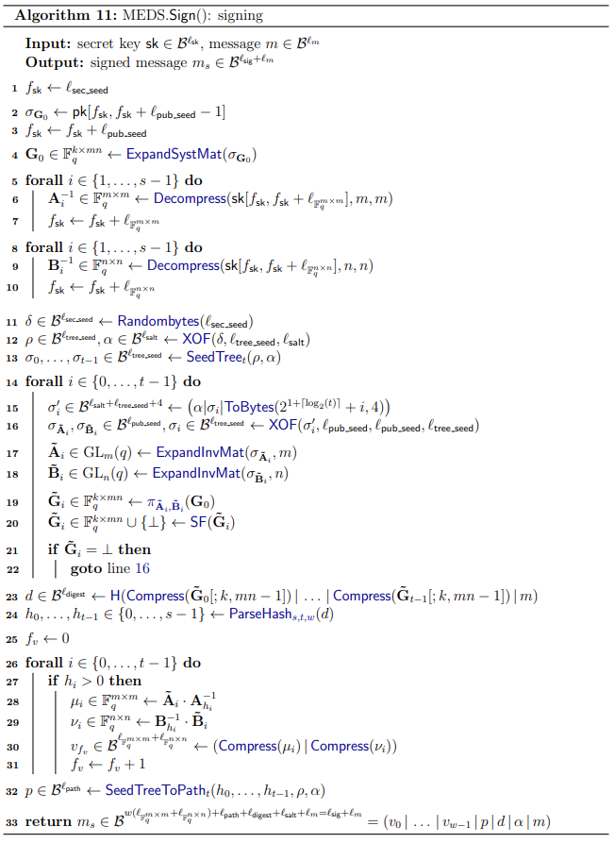
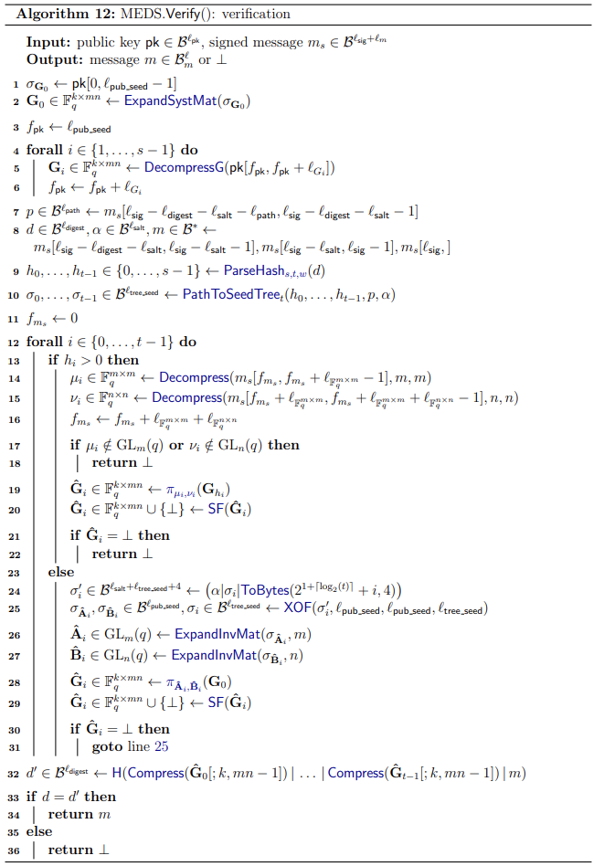
MEDS Sign and Verify
PRNG-related operations
Similar construction
(contributes 80-90% of clock cycles
Moved hash & compress inside for loop in order to save Block RAM utilization

Slide 10
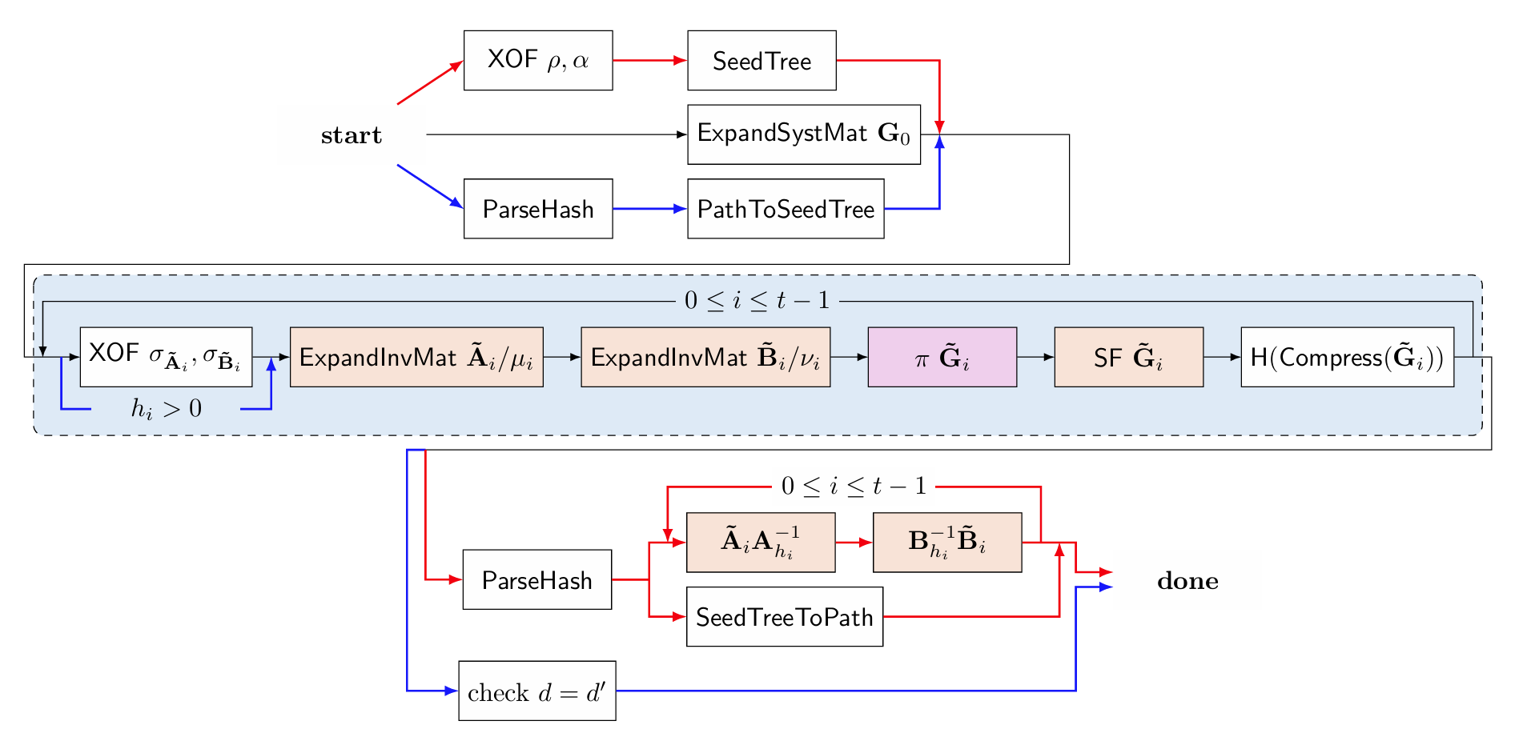
Combined Design for Sign and Verify
Red lines show sign only path, and blue lines show verify-only path.
Both prime fields, 2039 and 4093, are close; therefore, the underlying arithmetic to support both can be designed efficiently with minimum overhead.

Slide 11
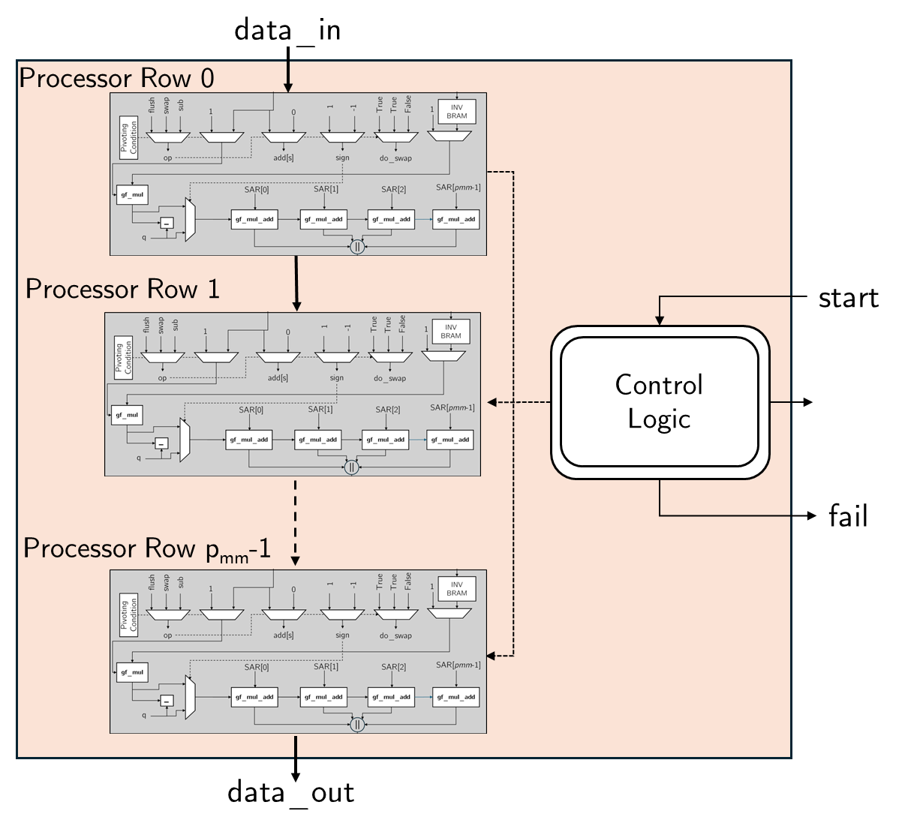
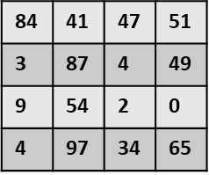
MEDS Hardware: XOF and ExpandInv
XOF
SigmaA, SigmaB
PRNG
(SHAKE256)
S₁ - performance parameter to adjust time taken by the Systemizer at the cost of area
e.g.,
A_{mxm}, B_{nxn}
generate B
redo
Systemizer
Identity?
No
yes
No
A & B
done?
A_tilde, B_tilde

Slide 12
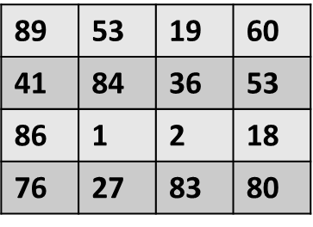
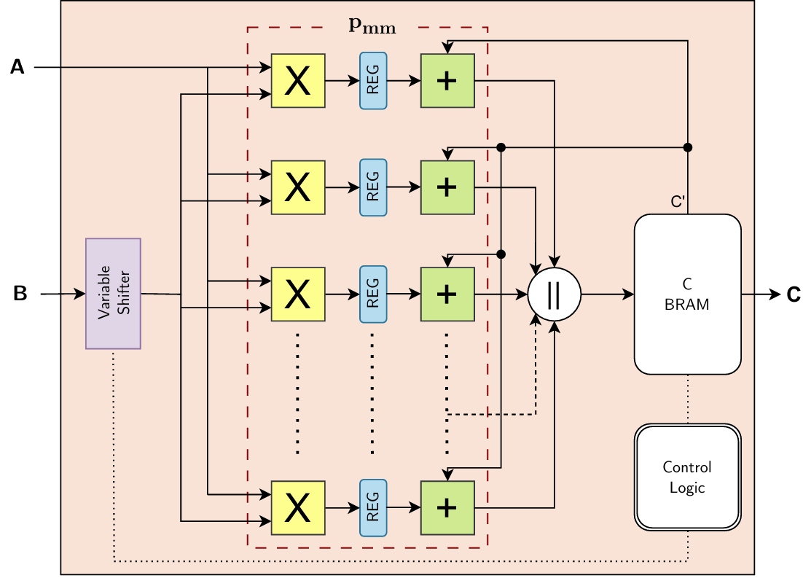
MEDS Hardware: π = AG₀B
G0_{kxmn}
89 | 53 | 19 | 60 | 41 | 84 | 36 | 53 | 86 | 1 | 2 | 18 | 76 | 27 | 83 | 80
46 | 96 | 31 | 58 | 77 | 1 | 83 | 27 | 72 | 10 | 3 | 50 | 27 | 88 | 19 | 43
56 | 5 | 40 | 100 | 82 | 45 | 57 | 53 | 79 | 77 | 59 | 16 | 55 | 13 | 53 | 82
82 | 26 | 45 | 94 | 86 | 82 | 83 | 30 | 54 | 90 | 65 | 67 | 70 | 13 | 6 | 97
S₂
A_tilde_{mxm}
B_tilde_{nxn}
S_{mat} represents another performance parameter to adjust number of matrix multiplication units running in parallel
Mat
Mul
AGB
Mat
Mul
AGB
Mat
Mul
AGB
Gi_{kxmn}
S₂: performance parameter to adjust time taken by the matrix multiplication at the cost of area
65 | 79 | 5 | 87 | 46 | 82 | 66 | 4 | 12 | 97 | 45 | 21 | 10 | 51 | 22 | 36
13 | 23 | 33 | 11 | 82 | 51 | 38 | 38 | 13 | 62 | 91 | 74 | 80 | 32 | 27 | 98
13 | 29 | 40 | 100 | 5 | 31 | 16 | 63 | 44 | 54 | 8 | 13 | 5 | 77 | 11 | 46
61 | 27 | 2 | 59 | 60 | 2 | 37 | 84 | 9 | 86 | 98 | 41 | 45 | 92 | 10 | 89

Slide 13
MEDS Hardware: SF Systemizer
65 | 79 | 5 | 87 | 46 | 82 | 66 | 4 | 12 | 97 | 45 | 21 | 10 | 51 | 22 | 36
13 | 23 | 33 | 11 | 82 | 51 | 38 | 38 | 13 | 62 | 91 | 74 | 80 | 32 | 27 | 98
13 | 29 | 40 | 100 | 5 | 31 | 16 | 63 | 44 | 54 | 8 | 13 | 5 | 77 | 11 | 46
61 | 27 | 2 | 59 | 60 | 2 | 37 | 84 | 9 | 86 | 98 | 41 | 45 | 92 | 10 | 89
S₃ - performance parameter to adjust time taken by the Systemizer at the cost of area
SF_Systemizer
1 | 0 | 0 | 0 | 34 | 38 | 83 | 99 | 74 | 92 | 13 | 95 | 80 | 57 | 41 | 10
0 | 1 | 0 | 0 | 14 | 7 | 65 | 53 | 60 | 91 | 28 | 93 | 67 | 52 | 38 | 42
0 | 0 | 1 | 0 | 85 | 16 | 2 | 69 | 94 | 40 | 16 | 6 | 88 | 15 | 66 | 28
0 | 0 | 0 | 1 | 33 | 27 | 46 | 86 | 32 | 85 | 37 | 79 | 15 | 8 | 85 | 51

Slide 14
MEDS Hardware: Compress and Hash
1 | 0 | 0 | 0
0 | 1 | 0 | 0
0 | 0 | 1 | 0
0 | 0 | 0 | 1
34 | 38 | 83 | 99 | 74 | 92 | 13 | 95 | 80 | 57 | 41 | 10
14 | 7 | 65 | 53 | 60 | 91 | 28 | 93 | 67 | 52 | 38 | 42
85 | 16 | 2 | 69 | 94 | 40 | 16 | 6 | 88 | 15 | 66 | 28
33 | 27 | 46 | 86 | 32 | 85 | 37 | 79 | 15 | 8 | 85 | 51
Hash
S₄ : performance parameter to adjust time taken by the hashing module

Slide 15
Comparison of Software vs Plain Hardware Implementations
Target FPGA: Artix 7, Frequency: 113 MHz
CPU: AMD Ryzen 7 PRO 5850U, Frequency: 1,900 MHz
x1.16
x1.16
x19.5
x19.6
{S₁,S₂,S₃,S₄,S_{m}} = {1, 7, 6, 6, 3}

Slide 16
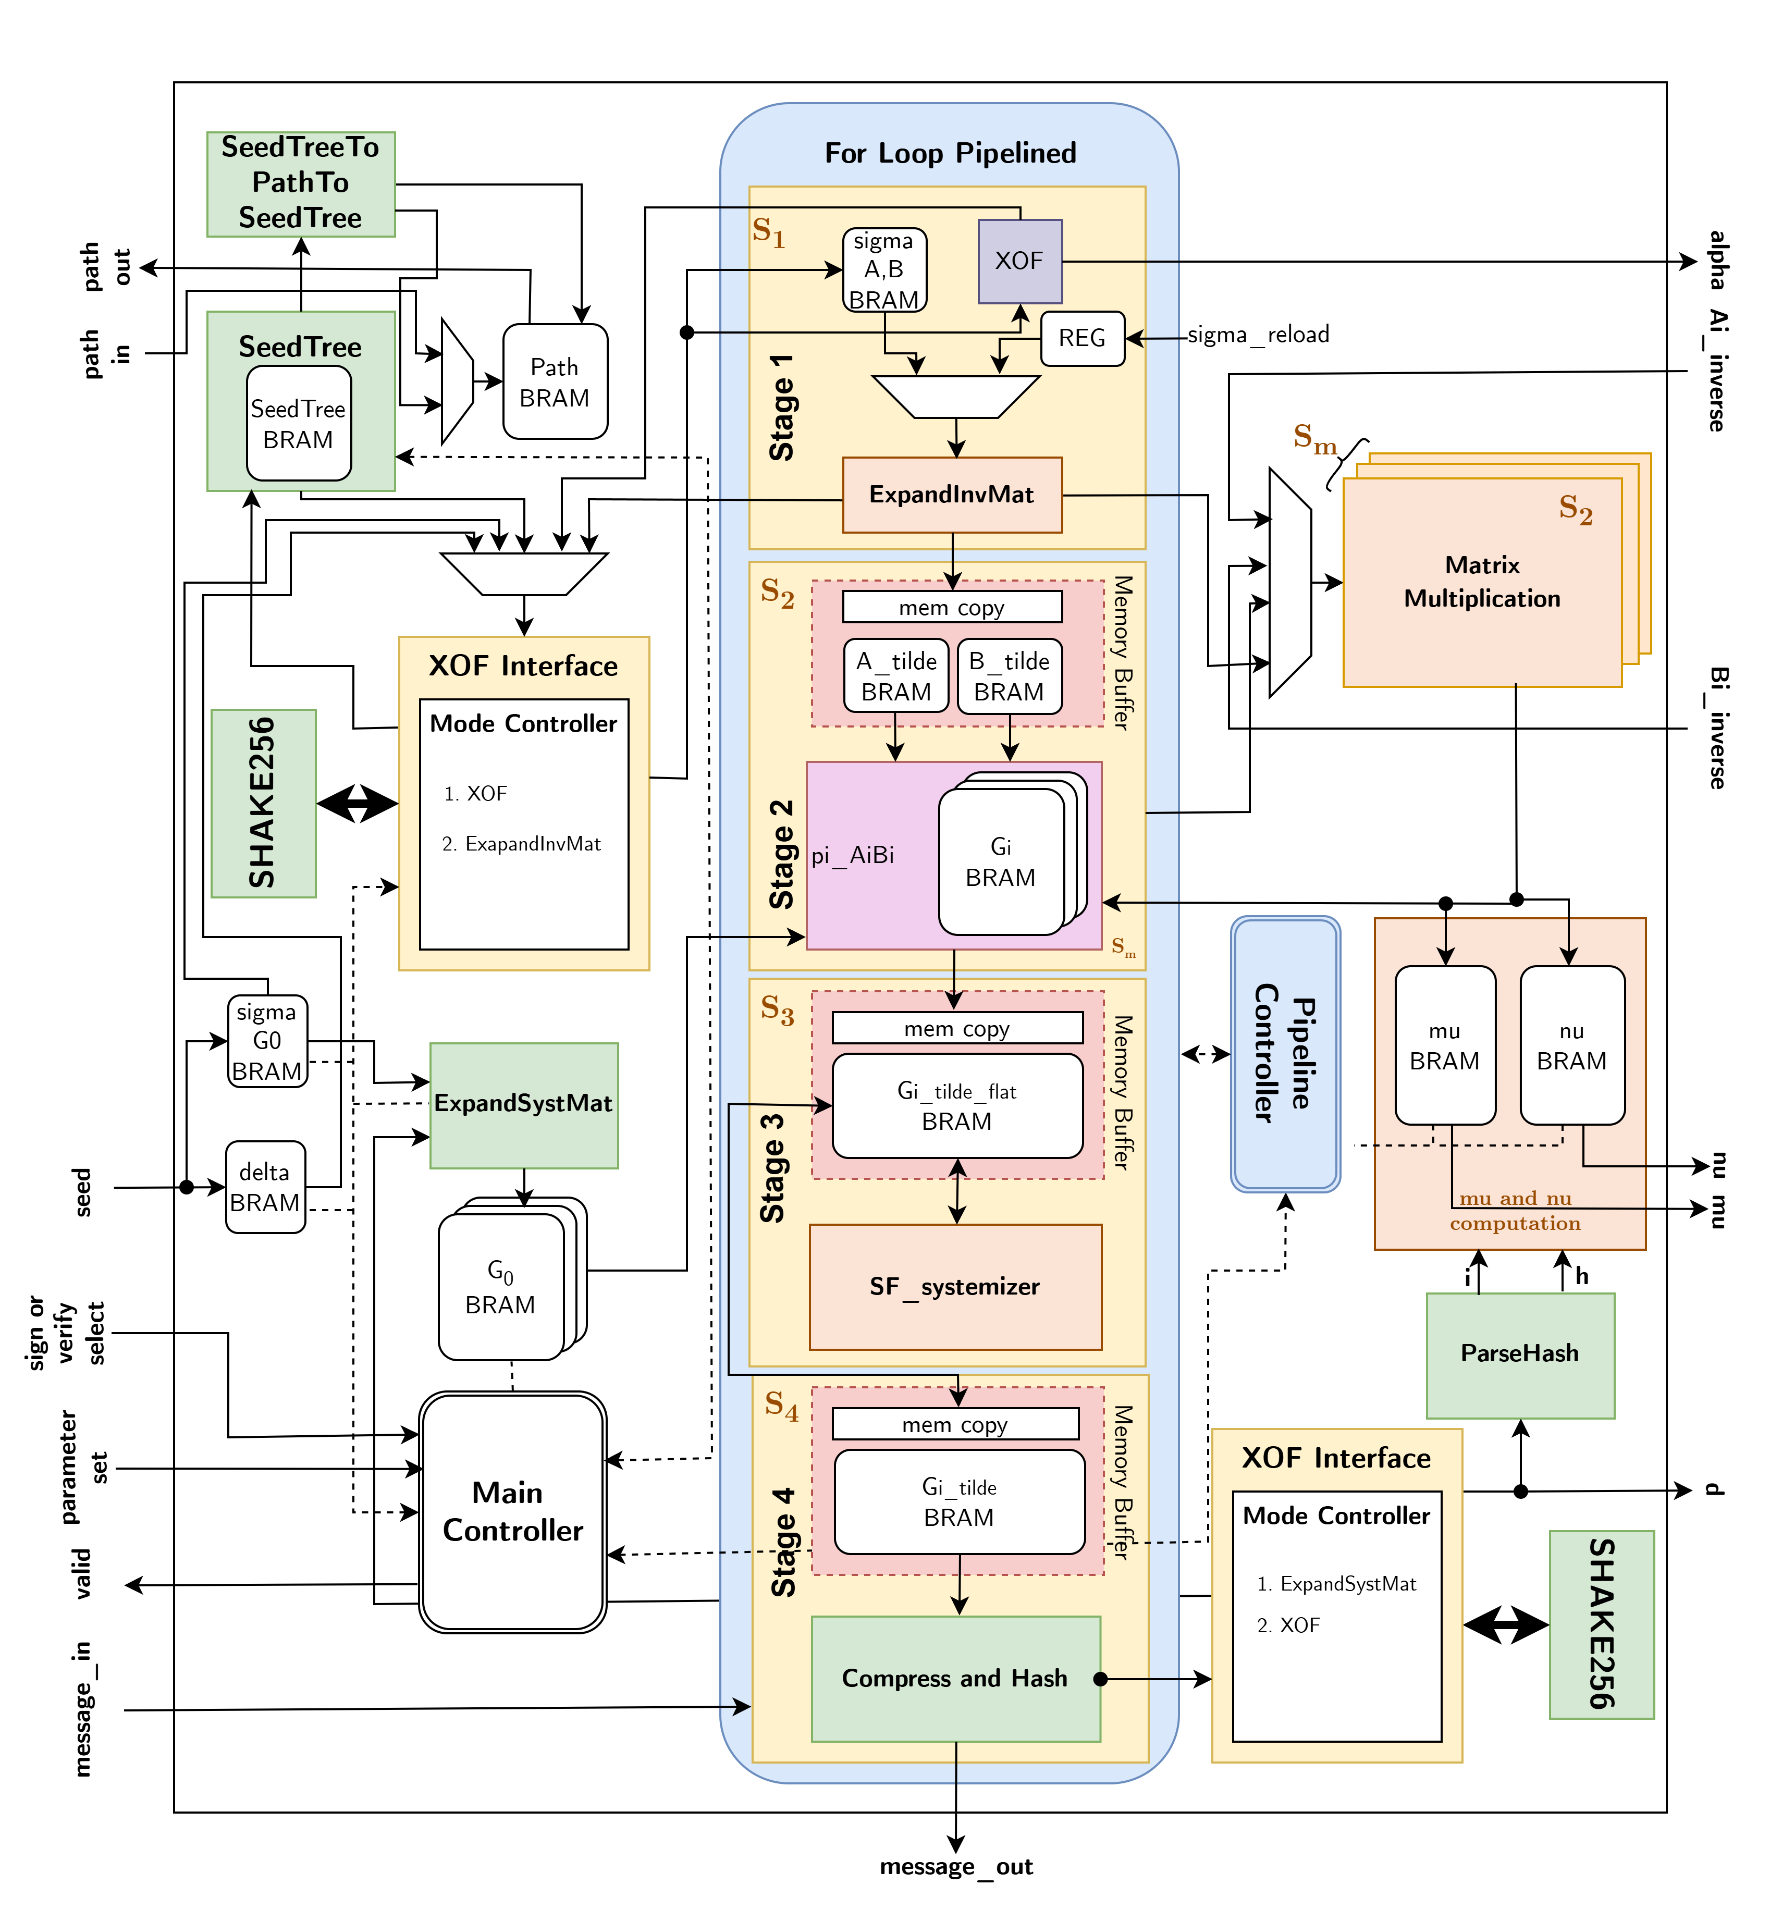
The Pipelined MEDS

Slide 17
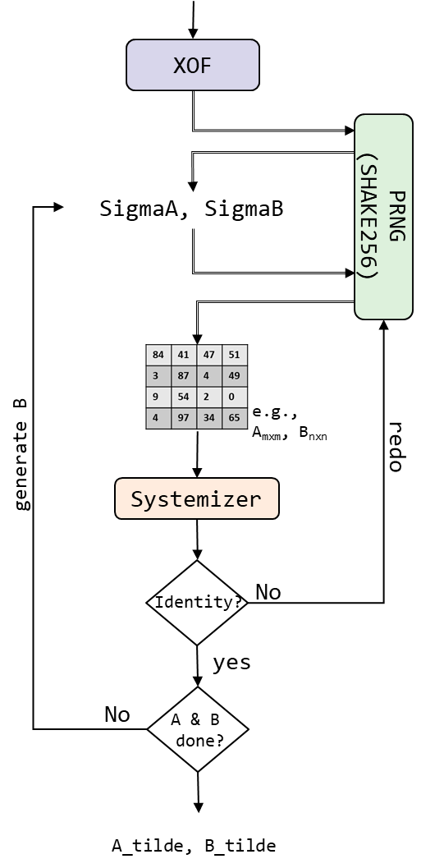
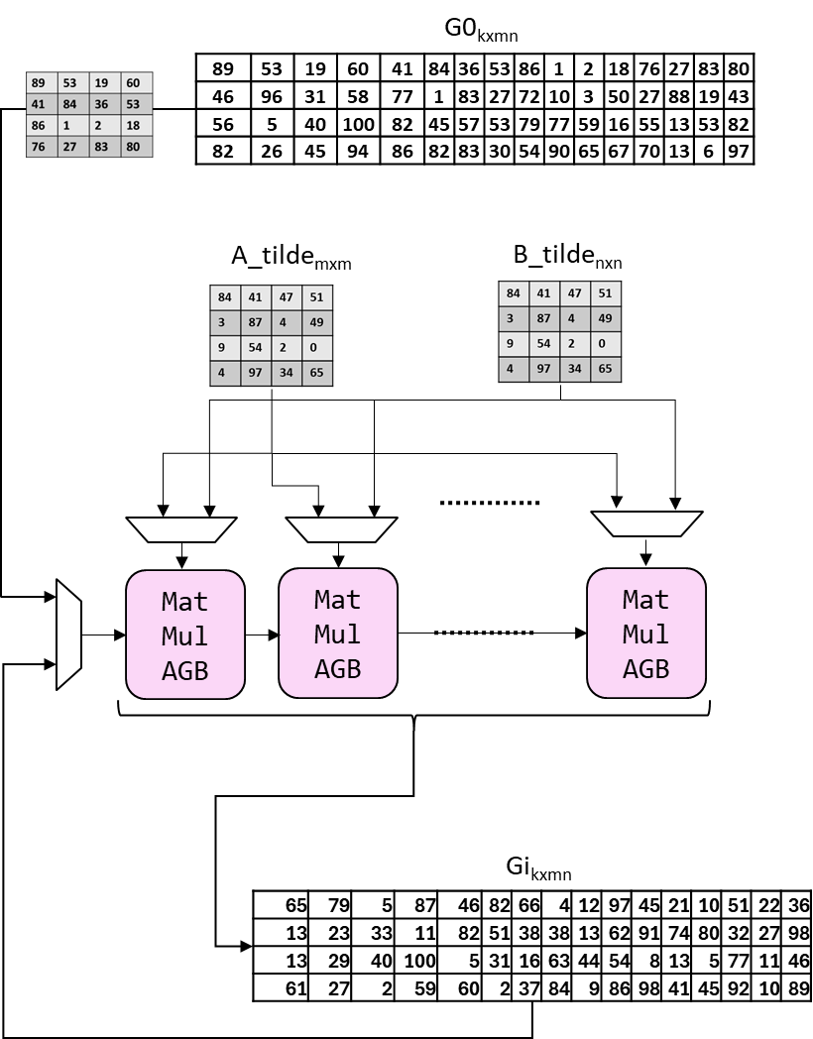
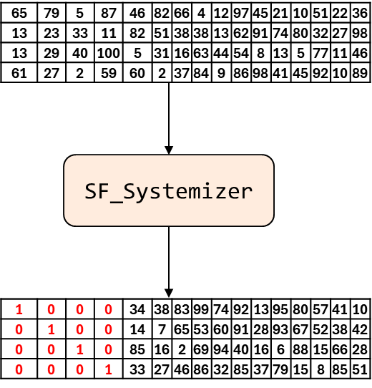
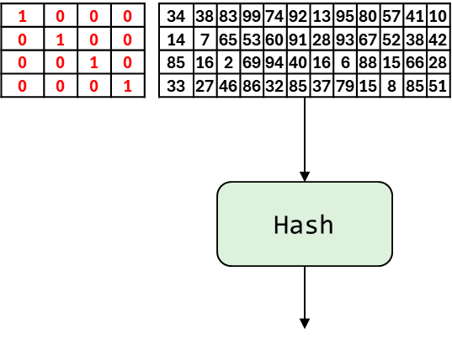
The Pipeline

Slide 18
The Pipeline
S₁,S₂,S₃,S₄ | Stage 1 | Stage 2 | Stage 3 | Stage 4
1 |  | 83,364 | 48,191 | 16,599
2 | 1,432 | 41,812 | 14,877 | 8,521
3 | 1,142 | 29,926 | 8,350 | 5,883
4 | 1,104 | 23,990 | 5,702 | 4,503
5 | 1,042 | 18,054 | 4,020 | 3,751
6 | 1,120 | 18,054
7 | 980 |  | 2,477 | 2,782
8 | 1,032 | 12,118 | 2,294 | 2,522
9 | 1,084 | 12,118 | 2,153 | 2,484
10 | 1,136 | 12,118 | 2,054 | 2,371
11 | 1,188 | 12,118 | 1,955 | 2,652
12 | 1,240 | 12,118 | 1,912 | 2,197
13 | 1,292 | 12,118 | 1,869 | 2,137
14 | 975 | 6,195 | 1,643 | 1,796
3,534
3,557
3,178
S₂= 7
12,132
S_{m} | Stage 2
1 | 12,132
2 | 6,066
3 | 3,033
… | …

Slide 19
Evaluation – Pipelined Hardware vs Plain Hardware vs Optimized Software Implementations
Target FPGA: Artix 7, Frequency: 113 MHz
CPU: AMD Ryzen 7 PRO 5850U, Frequency: 1,900 MHz
x69
x19
x70
x20
x4
x4
{S₁,S₂,S₃,S₄,S_{m}} = {1, 7, 6, 6, 3}

Slide 20
Comparison Pipelined Hardware vs Microcontroller
Target FPGA: Artix 7, Frequency: 113 MHz
Microcontroller: Arm Cortex-M4, Frequency: 20 MHz
Kannwischer, M. (2024). pqm4: Benchmarking additional post-quantum signature schemes [Presentation slides]. National Institute of Standards and Technology (NIST).

Slide 21
Efficiency of the Pipeline
Our hardware design architectures:
  Balanced –a balance between time and area
  High Performance –performance is a priority
 | 0% < Idle time < 10%
 | 10% < Idle time < 20%
Design Choice | Security Level | q | Performance Metrics |  |  |  |  | Stage-wise Idle Time %
 |  |  | S₁ | S₂ | S₃ | S₄ | S_{mat} | Stage 1 | Stage 2 | Stage 3 | Stage 4
Balanced | Level I | 4,093 | 1 | 7 | 6 | 6 | 3 | 3.6% | 0.0% | 3.4% | 6.1%
 | Level III | 4,093 | 1 | 11 | 8 | 9 | 5 | 0.5% | 1.7% | 0.0% | 0.5%
 | Level V | 2,039 | 1 | 10 | 10 | 12 | 5 | 0.0% | 4.4% | 2.8% | 5.8%
 | Unified Level {1,3,5} | Both | 1 | 10 | 10 | 12 | 5 | 3.4% | 5.5% | 15.4% | 15.7%
High Performance | Level I | 4,093 | 2 | 14 | 14 | 14 | 4 | 5.7% | 3.8% | 2.4% | 0.0%
 | Level III | 4,093 | 2 | 11 | 22 | 22 | 8 | 1.5% | 0.3% | 0.0% | 3.9%
 | Level V | 2,039 | 2 | 15 | 14 | 15 | 8 | 0.2% | 2.7% | 0.6% | 0.0%
 | Unified Level {1,3,5} | both | 2 | 14 | 14 | 14 | 4 | 18.4% | 1.3% | 17.5% | 13.9%
More combinations possible

Slide 22
Performance Comparison – NIST Security Level 1
Time = Sign + Verify
Target FPGA: AMD Artix 7 (except Falcon-512 – uses AMD Zynq)
Area (x10³ LUT)

Slide 23
Goal and Key Takeaways
MEDS offers plenty of parallelism on the low level, multiplying and systemizing matrices, as well as on the high level.
When compared to sign and verify times against optimized software implementation:
Balanced design: 4-5× improvement
High-performance design: 9-10× improvement
The sign and verify loops are similar, allowing resources to be reused with minimal control logic overhead.
The overhead for additional control logic for supporting different matrix dimensions and challenge lengths is marginal.

Slide 24



Tutorial on Security in Quantum Computing Era
Post-Quantum Cryptography to protect classical computers from Quantum Computer attacks
Security solutions to protect Quantum Computers themselves from attacks

Slide 25
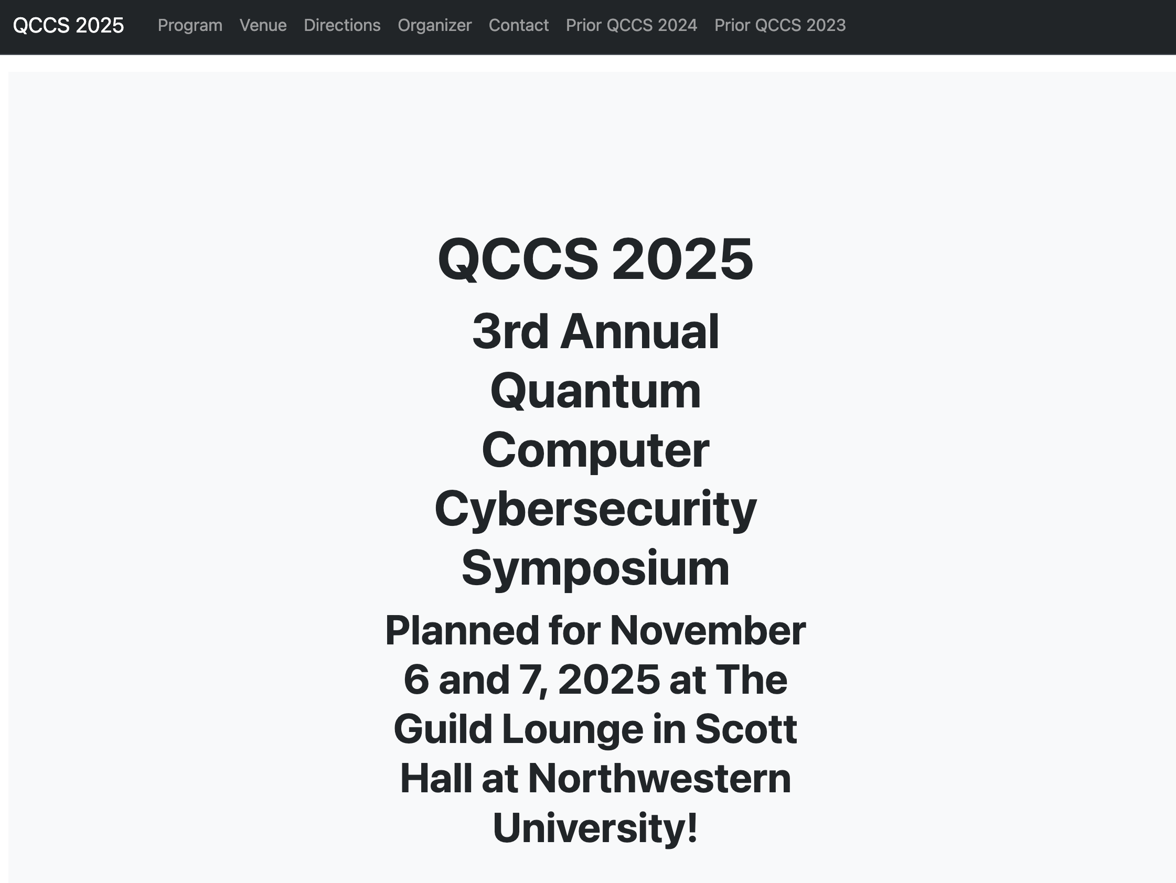

Quantum Computer Cybersecurity Resources
Quantum Computer Cybersecurity Symposium (QCCS ‘25)
Web: https://caslab.io/events/qccs

Slide 26


Quantum Computer Cybersecurity Resources
1st International Winter School on Attacks, Defenses, and Secure Design of Quantum Computing Systems (ADSDQC ‘25)
Web: https://caslab.io/events/adsqcs
In-person, hands-on instructions
and experimentation!

Slide 27
Unified MEDS Accelerator
Thank you!

Slide 28
Unified MEDS Accelerator
Sanjay Deshpande, Yongseok Lee, Mamuri Nawan, Kashif Nawaz, Ruben Niederhagen, Yunheung Paek, Jakub Szefer

Slide 29
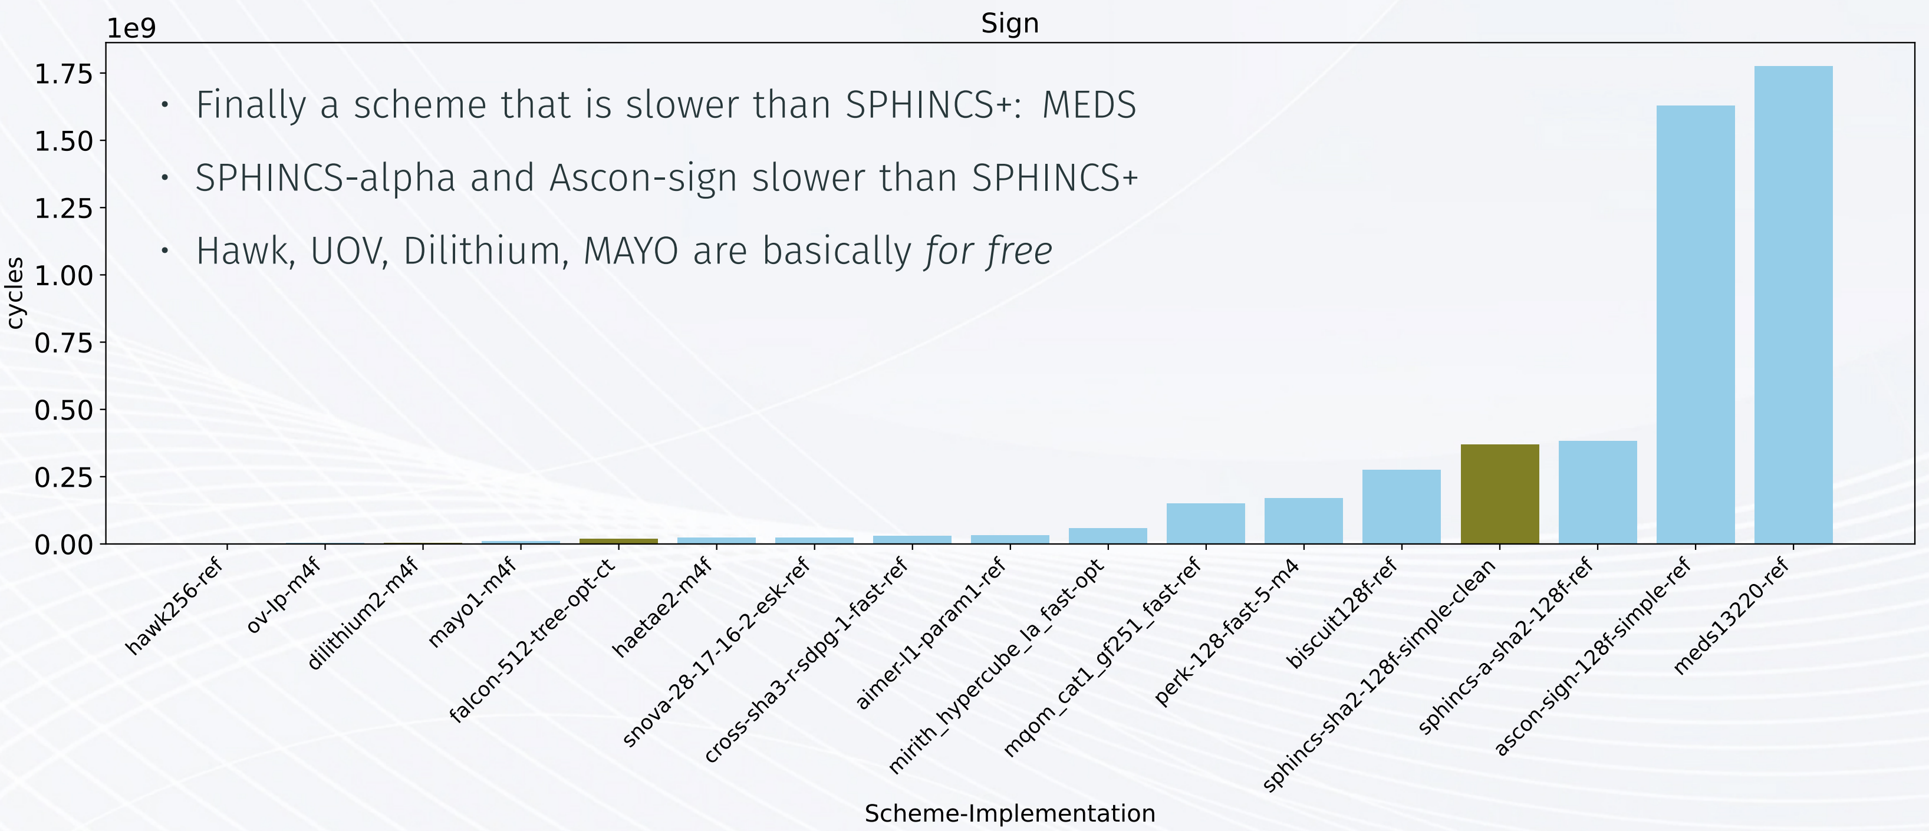
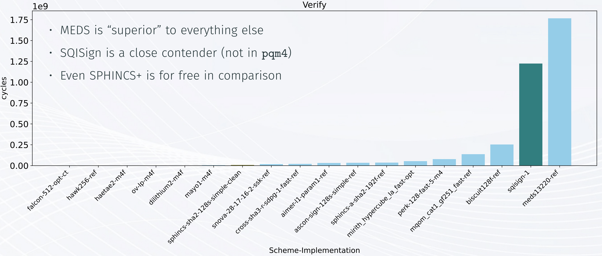
Motivation
MEDS is the slowest when comparing average execution speed for signature generation and signature verification when realized on a microcontroller.
Kannwischer, M. (2024). pqm4: Benchmarking additional post-quantum signature schemes [Presentation slides]. National Institute of Standards and Technology (NIST).

